Slide 1

File and Directory Permissions
Mina Gabriel

Slide 2
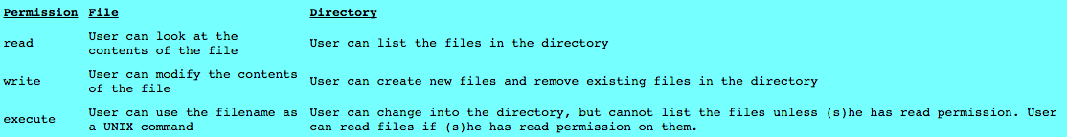
File and Directory Permissions
Interpretation of permissions for files and directories

Slide 3
As we have seen in the previous chapter, every file or directory on a UNIX system has three types of permissions, describing what operations can be performed on it by various categories of users. The permissions are:
read (r),
write (w),
and execute (x)
and the three categories of users:
user/owner (u),
group (g)
and others (o).
Because files and directories are different entities, the interpretation of the permissions assigned to each differs slightly.

Slide 4
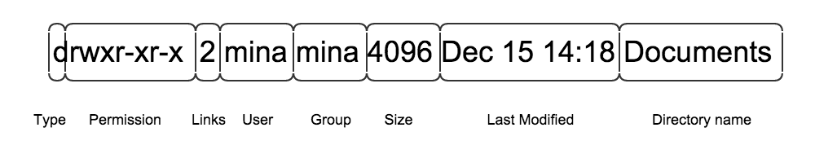
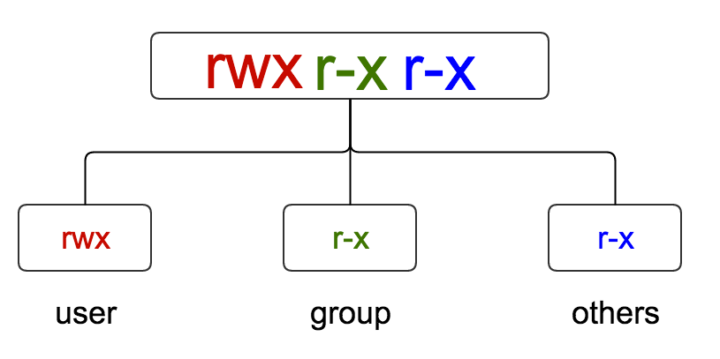

Slide 5
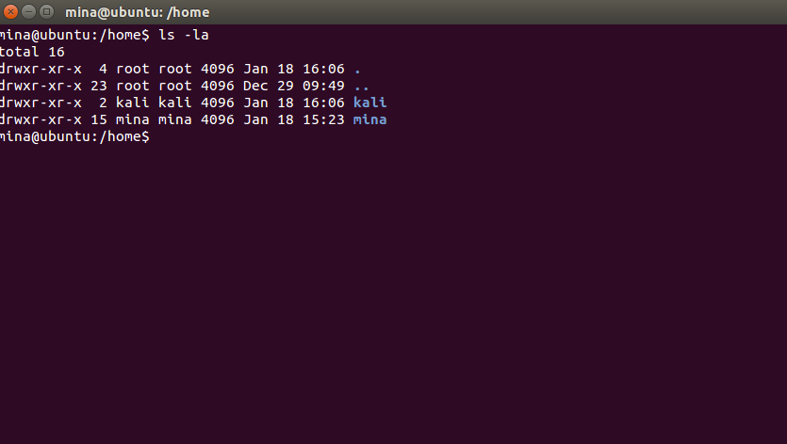
Remember to check permission on files/directories do
username@ubuntu:/home$ ls –la

Slide 6
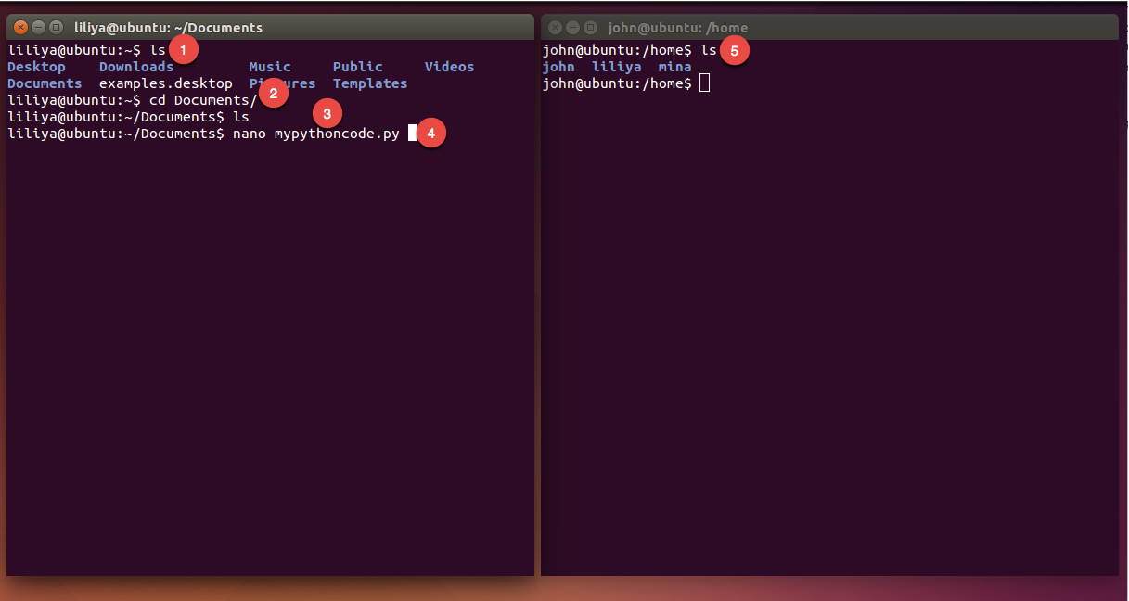
Example

Slide 7
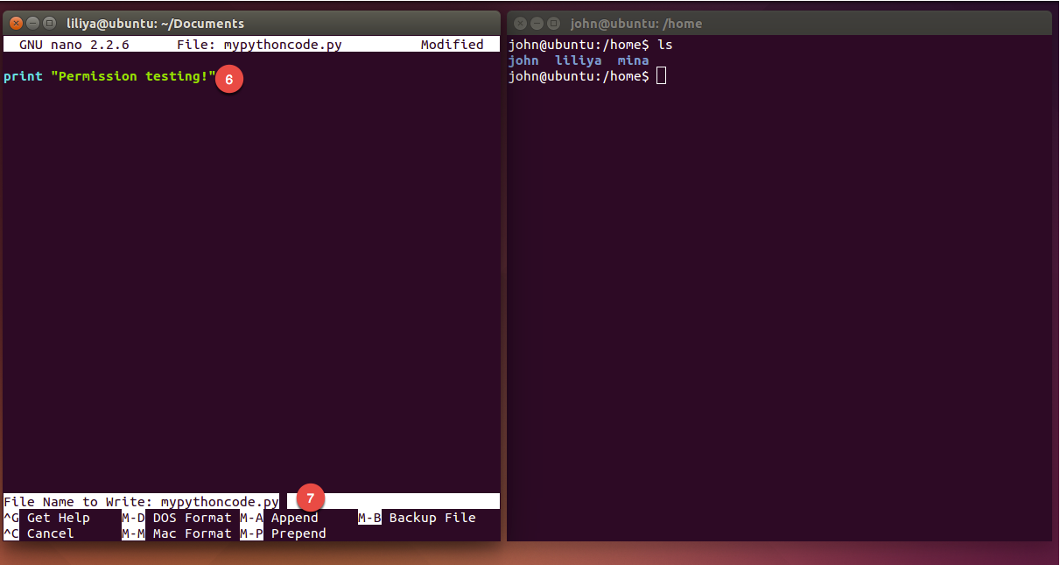

Slide 8
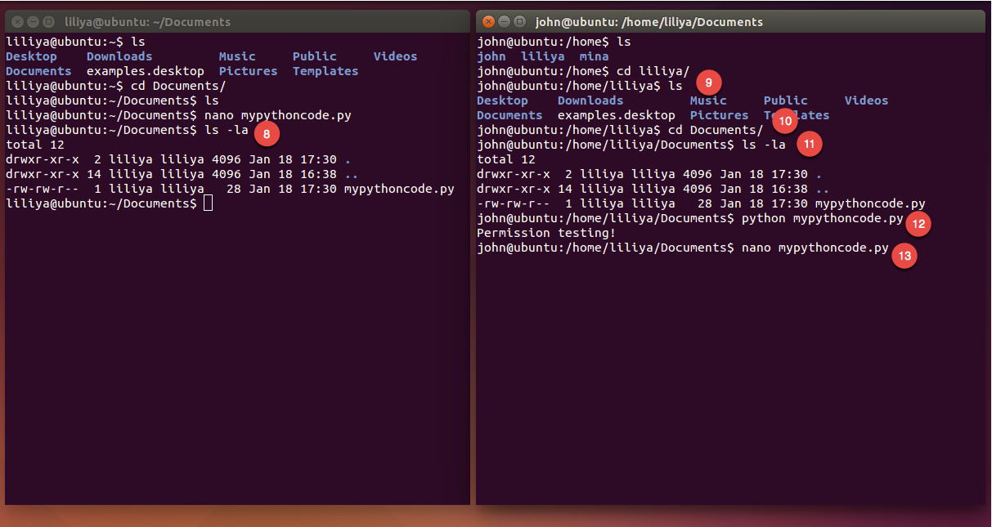

Slide 9
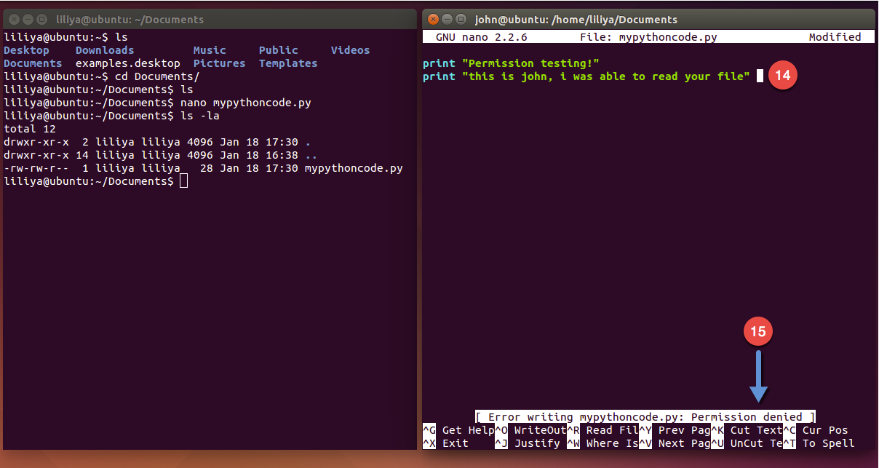

Slide 10
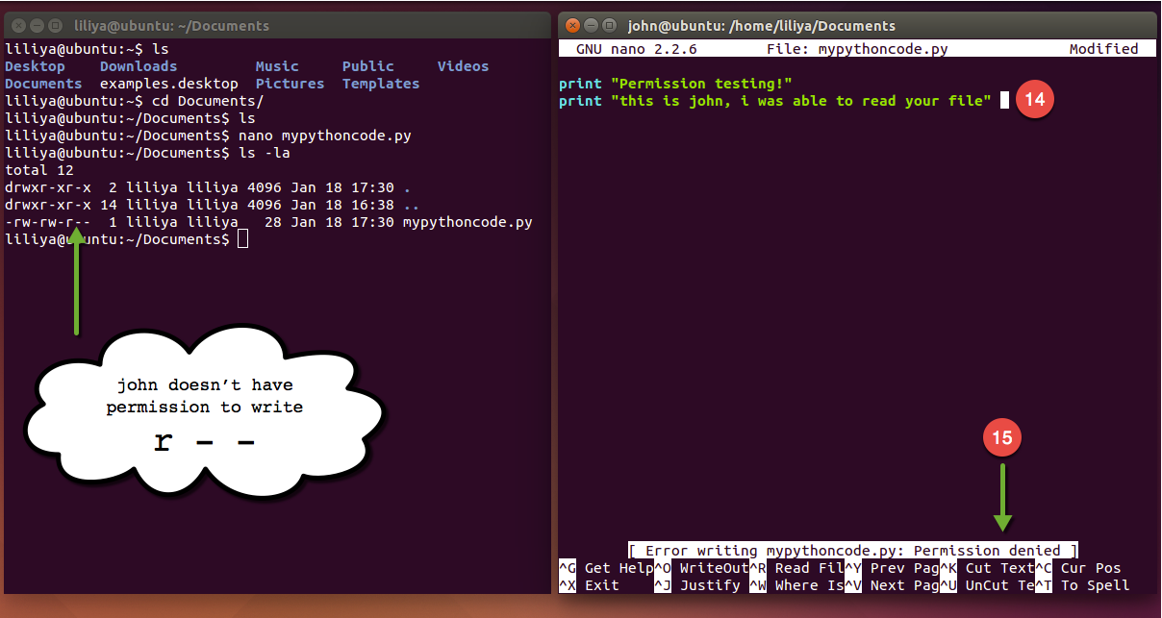

Slide 11
chmod
File and directory permissions can only be modified by their owners, or by the superuser (root), by using the chmod system utility.
$ chmod options files

Slide 12
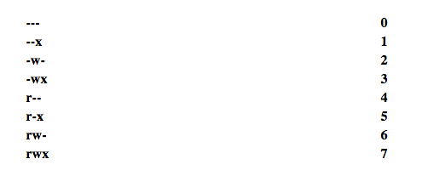
chmod accepts options in two forms. Firstly, permissions may be specified as a sequence of 3 octal digits (octal is like decimal except that the digit range is 0 to 7 instead of 0 to 9). Each octal digit represents the access permissions for the user/owner, group and others respectively. The mappings of permissions onto their corresponding octal digits is as follows:

Slide 13
For example the command:
Permissions may be specified symbolically, using the symbols u (user), g (group), o (other), a (all), r (read), w (write), x (execute), + (add permission), -(take away permission) and = (assign permission). For example, the command:
sets the permissions on all files ending in *.txt to rw-rw---- (i.e. the owner and users in the file's group can read and write to the file, while the general public do not have any sort of access).
$ chmod 600 private.txt
$ chmod ug=rw,o-rw,a-x *.txt

Slide 14
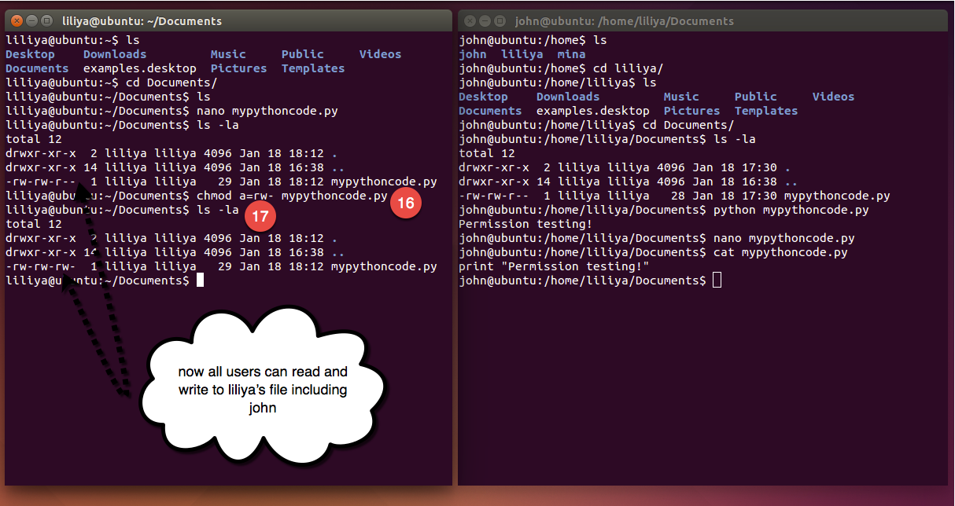

Slide 15
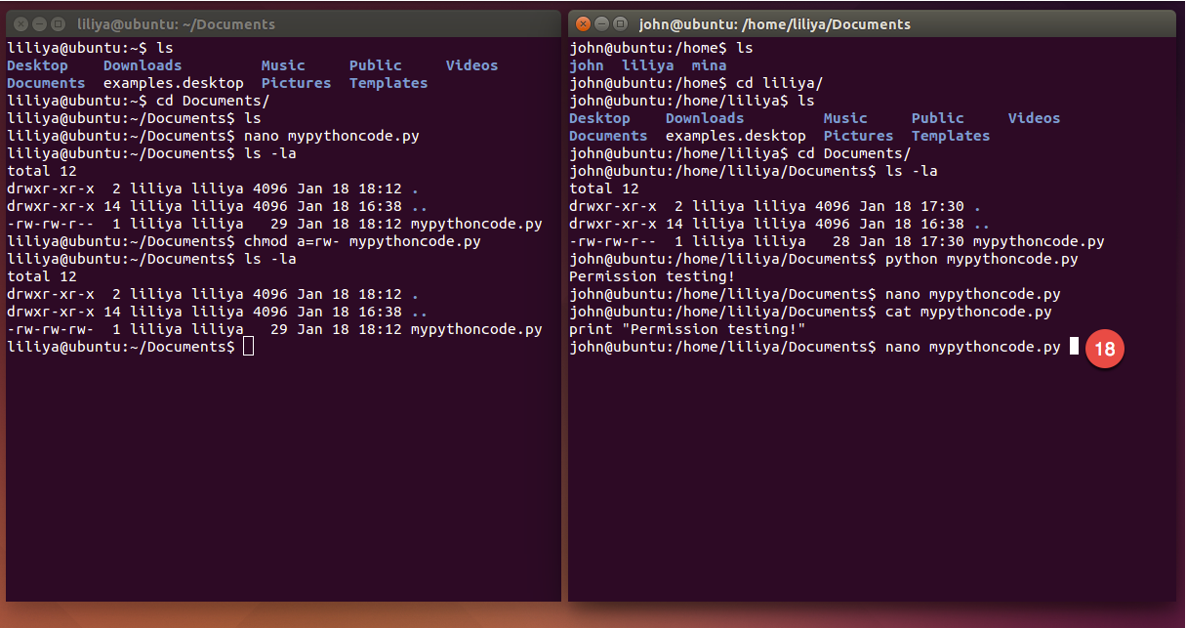

Slide 16
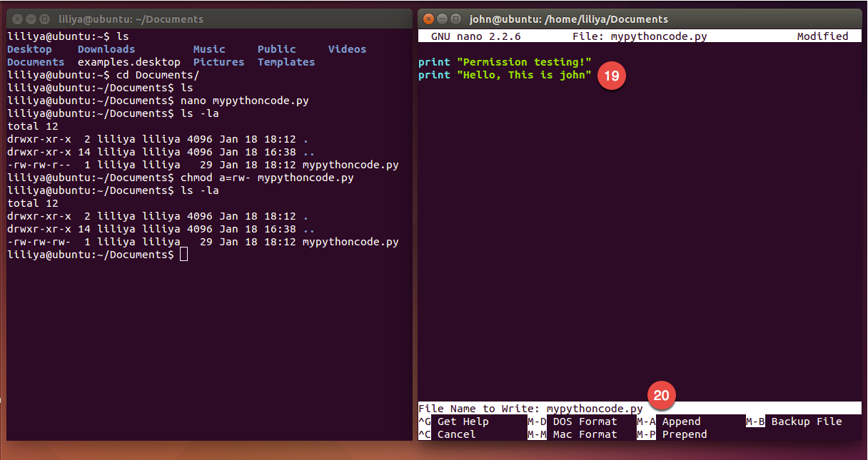

Slide 17
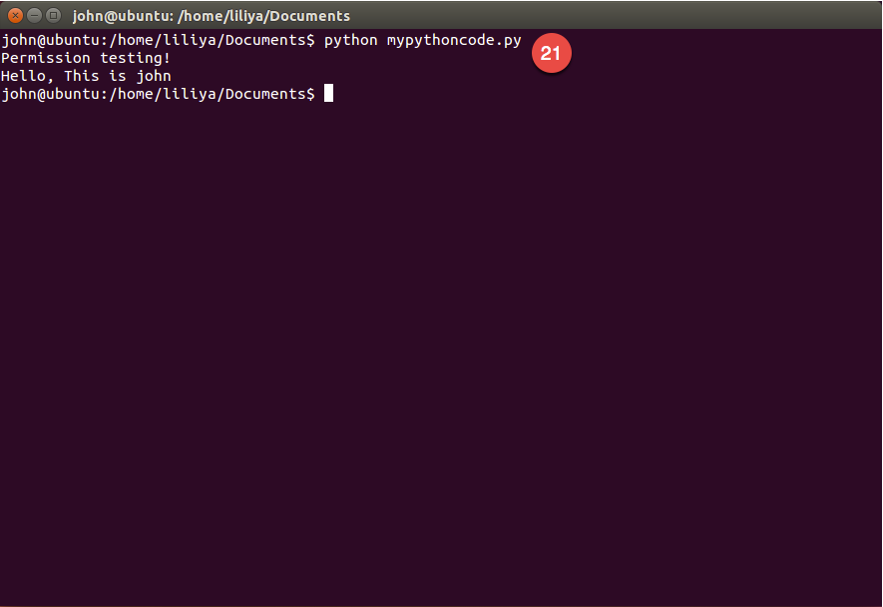

Slide 18
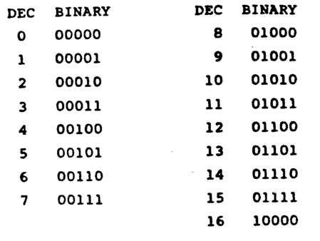
Summary
chmod is used to change the permissions of files and folders, with this command you have to specify the desired permission settings followed by the file name, there are two ways of changing permission symbolic and octal digit , the one that we will use in this class is the octal digit and this is how it works :
rwx rwx rwx = 111 111 111
rw- rw- rw- = 110 110 110
rwx --- --- = 111 000 000
*************************
rwx = 111 in binary = 7
rw- = 110 in binary = 6
r-x = 101 in binary = 5
r-- = 100 in binary = 4

Slide 19
Examples, mytext.txt file
only owner can read, write and execute
→ rwx --- ---
anyone can read, write and execute
→ rwx------ → rwx rwx rwx
no one can execute this file
→ rw- rw- rw-
others: can only read, group: can only write, owner: can read, execute
→ r-x -w- r--
$ chmod 700 mytext.txt
$ chmod 777 mytext.txt
$ chmod 666 mytext.txt
$ chmod 524 mytext.txt

Slide 20
Exercise class
inside CISC120 Directory create a text file called “hello.txt”:
open this file using your preferred terminal text editor and add some text.
change the file permission so that all users can edit this file.
create another txt file inside the same directory call it “hush.txt”
open this file using your preferred terminal text editor and add some text.
change the file permission so that you are the only one who can read, write and execute this file.

